Slide 1
How To Make Your Money Disappear Through Tax Write Offs
Dewayne Williams
CEO of MAC Enterprise Consulting & MAC Enterprise Tax Services

Slide 2
If THEY say the SKY is the LIMIT, then HOW can you REACH for the STARS?

Slide 3
Questions
Can you get a loan WITHOUT proving your INCOME?
How much INCOME does a LANDLORD want you to prove before RENTING to you?

Slide 4
How many of you already have your LLC (Limited Liability Company) and want to reduce your taxes?

Slide 5
Have you ever heard of a “Pass Through Entity”?
The Sole Proprietorship, Partnership, LLCs and S Corporations are recognized as a Pass Through Entities

Slide 6
Pass Through/Flow Through Entities
Legally pass all income to the owner/investor of the business.
Used to avoid double taxation on earnings.
Taxed only at the owner’s individual tax rate for ordinary income.

Slide 7
How a “Pass Through Entity” Works

Slide 8
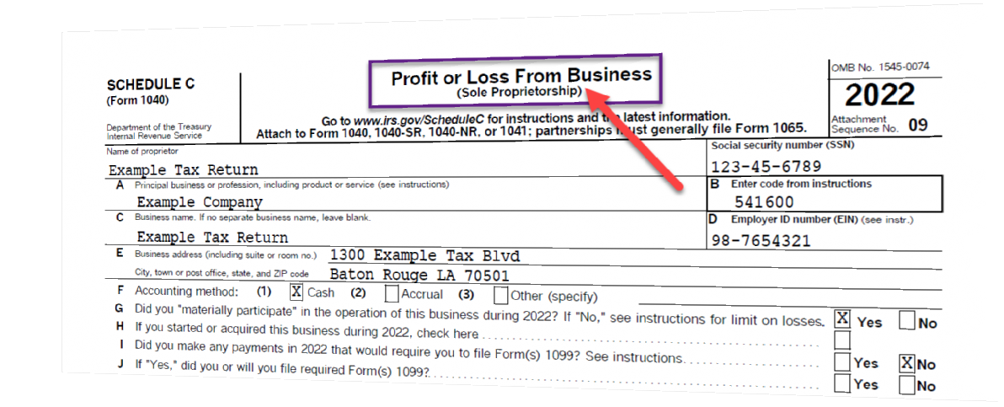
The Pass Through

Slide 9
The Write Off
Here are some common categories of business expenses that may qualify for a tax deduction:
Operating Expenses: These are the day-to-day costs of running your business and can include rent, utilities, office supplies, and the costs of products or raw materials.
Salaries and Wages: If your LLC has employees, their salaries and wages are typically deductible.
Professional Fees: Costs for services from lawyers, accountants, consultants, and other professionals are often deductible.
Travel Expenses: If you travel for business, expenses like lodging, meals, and transportation can be deductible.
Advertising and Marketing: Costs related to promoting your business, including advertising, marketing, and public relations expenses, are typically deductible.
Depreciation: If your business purchases property or equipment, you may be able to write off a portion of these costs each year through depreciation.
Interest on Business Loans: If you have taken out a loan for business purposes, the interest you pay on that loan is generally deductible.
Taxes: Certain types of taxes that your business pays can be deductible.
Insurance: Premiums for business insurance are typically deductible.
Retirement Plans: If your LLC has established a retirement plan for its employees, contributions to these plans can often be deducted.

Slide 10
Are you ready to get that LOAN to GROW your business?

Slide 11
Pros & Cons of Your Write Offs
PROS
CONS
Owe less taxes
Tax Refund
IRS doesn’t see money
The Bank can’t see your money either.
You can’t prove your income.
Can’t get a loan without proof of income.
Limited business growth

Slide 12
How did this happen & How do we fix this?

Slide 13
Do you want to know how to get the MOST tax benefits and grow your business?

Slide 14
Did you consider TAXES when you choose your BUSINESS STRUCTURE?

Slide 16
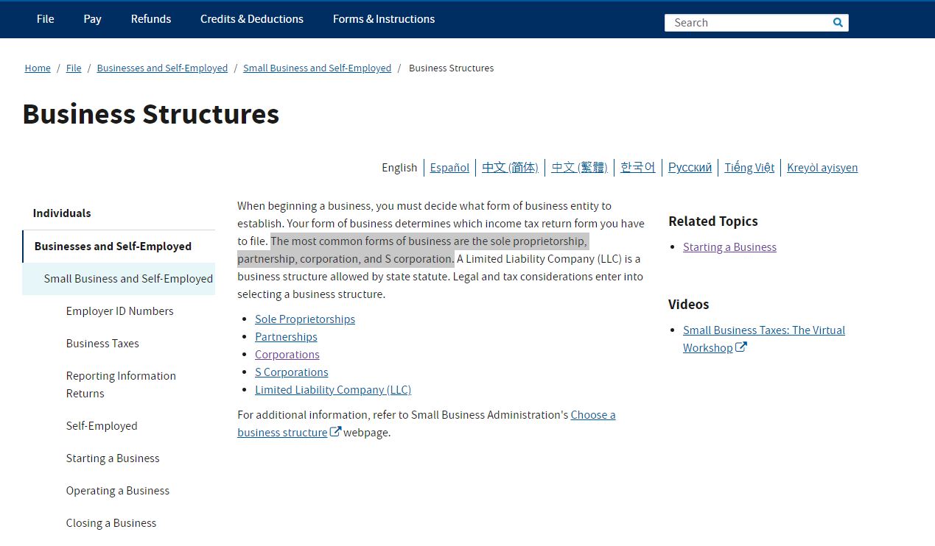

Slide 17
Treat your business as a separate person/entity!!!!

Slide 18
Classification of Taxpayers for U.S. Tax Purposes
United States Persons - The term ''United States person'' means:
A citizen or resident of the United States
A domestic partnership
A domestic corporation
Any estate other than a foreign estate
Any trust if:
A court within the United States is able to exercise primary supervision over the administration of the trust, and
One or more United States persons have the authority to control all substantial decisions of the trust
Any other person that is not a foreign person.

Slide 19
Which Tax Rate would you rather have? 27.3% or 21%

Slide 20
Tax Rates
Individual Tax Rate
27.3%
12% Federal Tax
15.3% Self Employment Tax
Corporate Tax Rate
21%

Slide 21
Your TAX STRATEGY will make all the difference!

Slide 22
Q&A
Question Time

